Slide 1

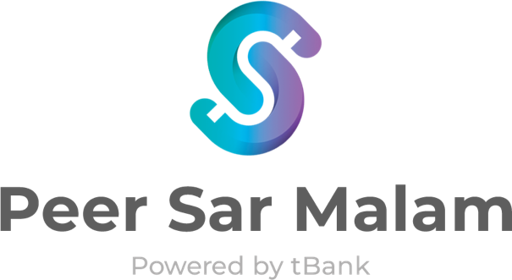
IS444 - Digital Banking Enterprise Architecture (Group 4)
Abel Wong
Mai Thanh Van
Tan Hui Rong
Timothy Soh
Truong Hai Bang
Xavier Lur

Slide 2


Target Market
Walkthrough scenario
Wants a way to secure a loan without hassle of documentations
Decent interest rate that is negotiable
24-year-old student studying in Singapore Management University (SMU)
Stays with her family and does not have debts
Spends with money she earns from part time job
Looking to buy a new laptop ($3,000)
Traditional banks are a hassle
High interest rate that varies according to her financial background
Notes:
Tim, Van

Slide 3




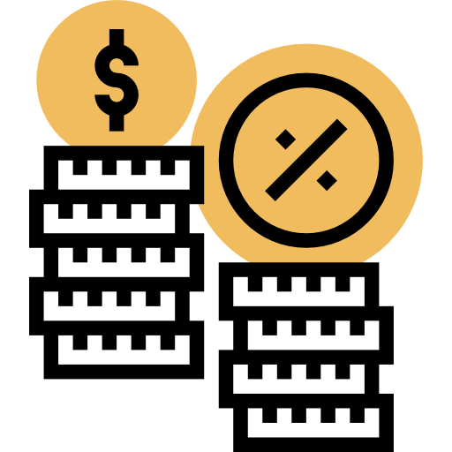







Issues with current loan process
Time-consuming
Manual Documentation
Lack of Availability
Non-competitive Interest Rates
Double Financing
and Fraud
Target Market
Pain Points
Who We Are
Benefits
Architecture
APIs Used
Notes:
Therefore, there should be a platform to simplify loan process, so that it’ll take borrower shorter time to apply for the loan, while the lender can make extra money.

Slide 4



Introducing Peer Sar Malam
Peer-to-peer Loan Marketplace
Trusted Third Party For Banks
Focus on Cash Management
Borrower:
Request fundings
Loaner:
Maximise their liquidity position by offering loan.
Currently utilises a wide range of tBank APIs to connect borrowers & lenders.
Provide tools for both borrower and loaner to maximise their cash
Target Market
Pain Points
Who We Are
Benefits
Architecture
APIs Used

Slide 5
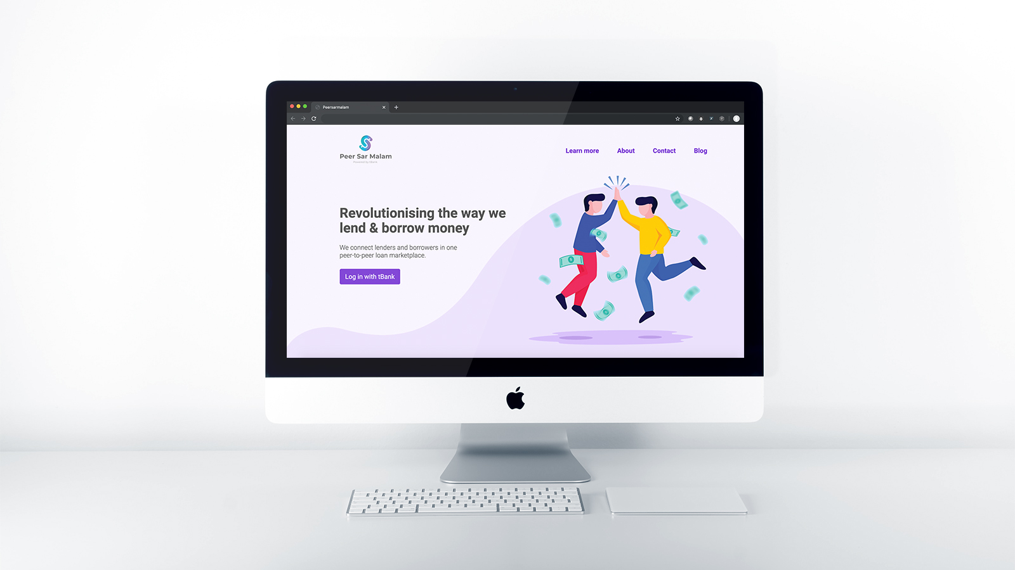





How we revolutionise the loan marketplace
P2P 1:1 Money Lending
Competitive Interest
Utilises Open Digital banking APIs
Automated dispute resolution
Faster processing capabilities
Notes:
Tim, Van

Slide 6
Why Peer Sar Malam?
Reduces the hassle of extensive checks and document submission
Faster processing of loans for the customer (Potential to secure a loan within a day)
Competitive interest rates
Host of platform tools: Analytics, reminders, dispute resolution
Maximise liquidity management for customers
Target Market
Pain Points
Who We Are
Benefits
Architecture
APIs Used
Notes:
Tim, Van

Slide 7
Demo

Slide 8
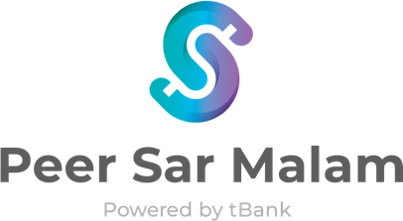



System architecture
UI Layer
User Interface
Angular 7
TBANK
Express Framework
Enterprise Platform Layer
API GATEWAY
Information Service
Loan Service
Account Service
Authentication Service
Customer Service
Transaction Service
Market Data Service
Notification Service
Payment Service
Product Service
Data Layer
SQL DB
SQL DB

Slide 9




API services used from tBank
Acount
Authentication
Customer
Payment
getDepositAccountDetails
requestOTP
getCustomerDetails
getBeneficiaryList
loginCustomer
getCustomerAccounts
addBeneficiary
creditTransfer
Target Market
Pain Points
Who We Are
Benefits
Architecture
APIs Used

Slide 10



API services used from tBank
Market Data
Notification
Payment
Product
getBenchmarkInterestRates
sendSMS
calculateFullLoanRepayment
getStandingInstructionList
sendEmail
calculateLoanInstallment
addStandingInstruction
removeStandingInstruction
Target Market
Pain Points
Who We Are
Benefits
Architecture
APIs Used

Slide 11

Internal Peer Sar Malam APIs
Loan Service
Information Service
getAllLoans/:status
getLoanInfo/:loanId
getCustInfo/:customerId
getBorrowerLoans/:status-:id
setLoan/:status
getLoanerLoans/:status-:id
createLoan
Target Market
Pain Points
Who We Are
Benefits
Architecture
APIs Used
Notes:
So aside from the 16 tBank APIs we have used in this project, our team took the extra mile to develop a couple of internal APIs to enhance our project. The APIs that we have developed include xxx and xxx. These APIs were used in xxx and xxx, as shared in the demo earlier.

Slide 12
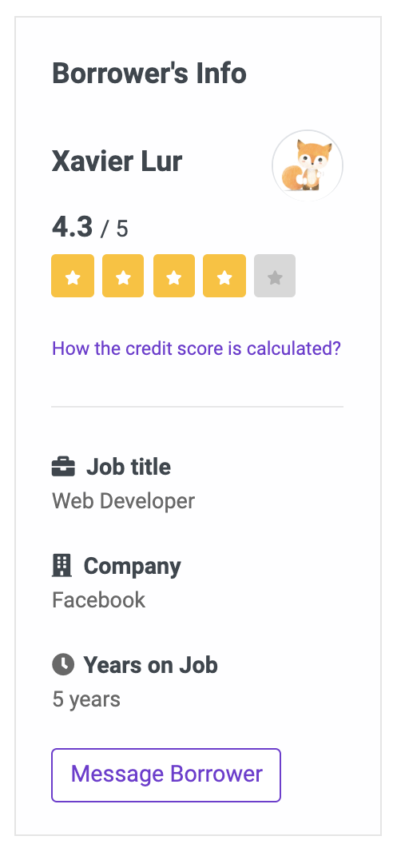
Future of Peer Sar Malam
Implementing the ‘Message Borrower’ feature
Onboarding other new banks onto Peer Sar Malam with tBank’s APIs
Notes:
In our next iteration of the Peer Sar Malam, we hope to build on our message borrower feature. Given the limited amount of time of this project, we could only display it in the frontend. The idea of the message borrower feature is to allow lenders to communicate or contact borrowers to find out more about the loan. This feature could be achieved using tBank’s email and SMS APIs.
In addition to the message borrower feature, once tBank has been dockerised and commercialised, we can onboard new banks to be part of the Peer Sar Malam ecosystem using the same tBank APIs as what we have implemented in this project. This will allow Peer Sar Malam to increase its user base.

Slide 13
Questions?

